Slide 1



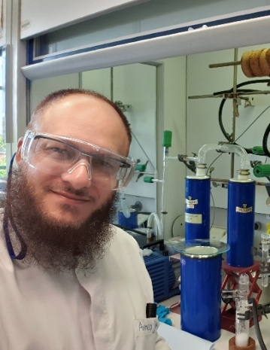
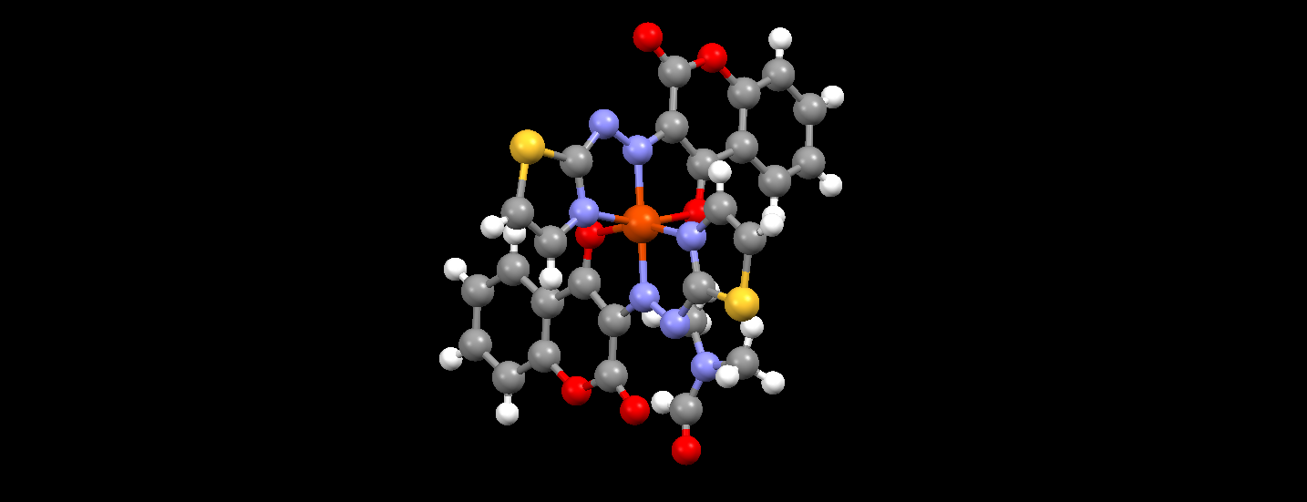
DESIGN AND SYNTHEISIS OF SMALL MOLECULES WITH HIGH
PHARMACOLOGICAL AND THERAPEUTIC POTENTIAL
Contact person/Group leader:
Prof. Dr.SC. Ahmed JASHARI
Affiliation
Group of Chemistry, Faculty of Natural Sciences and Mathematics,
University of Tetova, North Macedonia
Mail address
Ilinden nn, 1200 Tetova, North Macedonia
Email/website
ahmed.jashari@unite.edu.mk; ahmed.Jashari@gmail.com; ahmed.Jashari@outlook.de.
Group Members
Prof. Dr.sc. Ahmed Jashari; MSc. Fatjonë Krasniqi; Msc. Rina Krasniqi; Bsc. Belma Banjica; Msc. Mirlinda Abdullai.
Google Scholar
https://scholar.google.com/citations?user=9m5jma8AAAAJ&hl=en
Research Gate
https://www.researchgate.net/profile/Ahmed-Jashari
Research lines
Investigation of electrophilic and nucleophilic attacks on the coumarin core.
Design and synthesis of novel small molecules with high anticancer activity, mainly based on coumarins and flavonoids.
Synthesis of complex compounds using some coumarin derivatives as ligands.
Design and synthesis of novel hybrid molecules with two and more pharmacophores.
Phenyl mymics and incorporation of Carboranyl cluster in coumarin and flavonoid derivatives
Investigation of novel carboranyl derivatives for utilization in BNCT
Investigation of novel versatile catalysts for Baylis-Hillman and Stetter Reactions.

